Slide 1
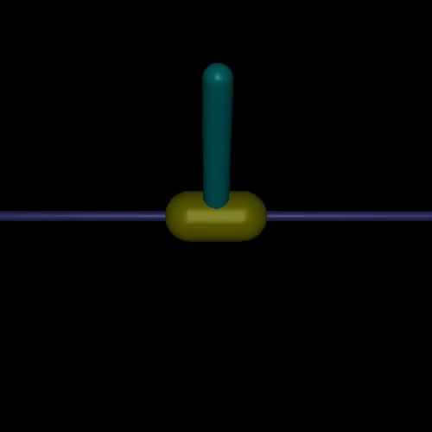
Reflexes for More Effective RL
MuJoCo environment for real-time training of QuickNet that adaptively responds to the environment
Added perturbation parameters:
Frequency: every 2-4 seconds
Duration: 20 ms
Perturbation: between (0 - x* g)
Perturbation direction: Randomly left and right
Environment parameters:
Agent Reaction speed: 40 ms*
Force: -3, 3
Episode parameters:
Maximum steps: 1000*
Reward per step: 1
Max total reward: 1000*
Algorithm parameters:
Initial timesteps to sample: 25000*
Maximum timesteps: 100000*
Update steps: 75000*
* Parameters that change with reaction speed

Slide 2
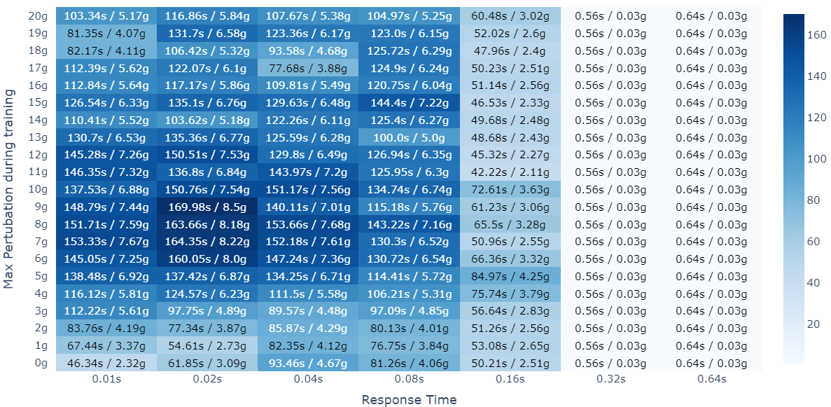
Varying response rate changes the problem difficulty
Avg. seconds in test environment / Min. Perturbation force required for failure
Test environment: The perturbation is applied every 5 seconds and is increased by 0.25g every time it is applied.
The sweet spot of response rate:
Not too fast: An agent that responds too fast will need to learn a larger number of states. Making it harder to learn.
Not too slow: An agent that is too slow to respond will fail when fast perturbation is applied
Avg. over 5 trials

Slide 3
Adding adaptive response improves performance
Algorithm
Process current state to get action.
If Reflex: start within 0.02 seconds and remain for 0.06 seconds
Else: start at 0.08 seconds
Network | Network | Avg. Seconds / Perturbation force | Avg. Actions / Decisions
Network 1 0.04s reaction speed | Default 0.04s | 144.64 / 7.232 | 3616.0
 | Reflex Network | 146.34 / 7.317 | 3659.14
Network 2 0.08s reaction speed | Default | 111.8 / 5.59 | 1397.5
 | Reflex Network | 122.25 / 6.112 | 1528.26
Network 3 0.16s reaction | Reflex Network | 95.3 Original: 84.97
Fast reflex (0.02s)
Action
Original network with 2 hidden layers with 256 neurons
The reflex acts at angles > 0.19. The agent fails at angle 0.2.
Reflex Networks learn a better policy.
During evaluation, reflexes are rarely activated.
3 added neurons for reflex

Slide 4
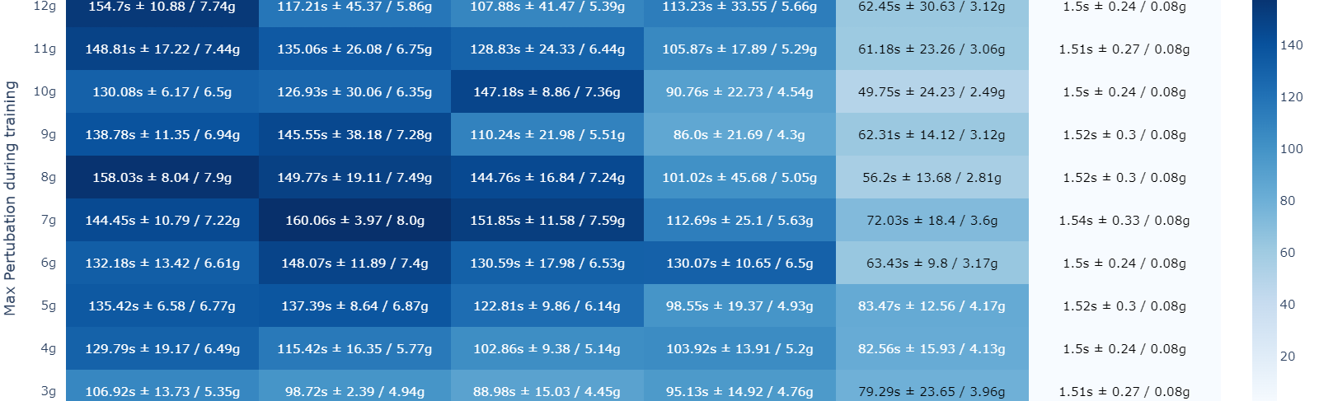
Why is quicker reaction speed not better?
It should be at least as good as the slower reaction speed if not better.
More total states while the network size and the replay memory size is the same
More steps to reward requiring more exploration initially also slowing training
Percentage of useful state action transitions to in the replay memory is reduced initially

Slide 5
Boredom based training
Start with a slow response time
Train until the TD-error is below a certain threshold
Reduce the response time
Repeat 1
s₁
s₂
a₀ , reward = 1
S_{1.5}
a₀ , reward = 0.5
a₁ , reward = 0.5
S_{1.25}
a₀ , reward = 0.25
a₁ , reward = 0.25
a₂ , reward = 0.25
a₃ , reward = 0.25
Possible advantages:
Faster learning / reduced need for exploration
Improve performance for fast response rates
Can learn the states with high TD error after transition and thus allow for adaptive time slicing
It should add precision to the Q values

Slide 6
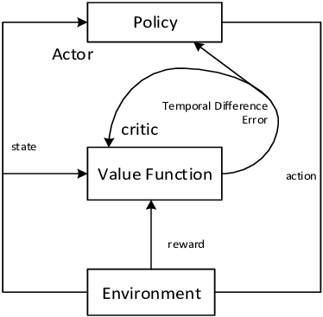
Automatic time slicing using dopamine
Problem setting: We have four different policies available for the same task and what to reduce the number of actions picked/ forward passes while maintaining the accuracy of the fastest response time.
Proposed method:
Train four networks with different response times using actor critic:
After training, let the actor choose from all four networks
Depending on the TD error based on the critic from the fastest
Network.
A low TD error means that the actions being performed are
near optimal and thus cause boredom resulting in actor picking coarser actions.
A high TD error means that the actions being performed are not optimal and the actor would benefit
from picking faster response resulting in finer control.
Actor
Network 1
20ms
Network 2
40ms
Network 3
80ms
Network 4
160ms
TD Error low
TD Error high
Critic (from 20ms network)
Value Function
TD Error
Near optimal
Environment

